Slide 1
Functional Dependencies & Normalization

Slide 2
Functional Dependencies
Examples and Exercises

Slide 3
What is Functional Dependencies?
A functional dependency is a relationship that exists between two attributes.
It typically exists between the primary key and non-key attribute within a table .
Symbol:
X → Y

Slide 4
Functional Dependencies
X → Y
Here, if X determines Y, then for every value of X, there is exactly one value of Y
The left side of FD(Functional Dependencies) is known as a determinant, the right side of the production is known as a dependent.

Slide 5
Functional Dependencies
Assume we have an employee table with attributes: Emp_Id, Emp_Name, Emp_Address.
Here, Emp_Id attribute can uniquely identify the Emp_Name attribute of employee table because if we know the Emp_Id, we can tell that employee name associated with it.
Functional dependency can be written as:
Emp_Id → Emp_Name

Slide 6
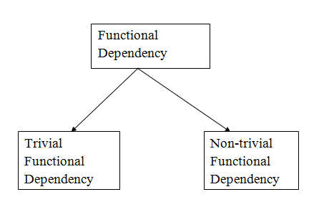
Types of Functional Dependencies
There are two types of Functional Dependencies:

Slide 7
Trivial functional dependency
A → B has trivial functional dependency if B is a subset of A
The following dependencies are also trivial like: A → A, B → B

Slide 8
Example of Trivial functional dependency
Consider a table with two columns Employee_Id and
Employee_Name.
{Employee_id, Employee_Name} → Employee_Id is a trivial
functional dependency as Employee_Id is a subset of
{Employee_Id, Employee_Name}.
Also, Employee_Id → Employee_Id and Employee_Name → Employee_Name are trivial dependencies too.

Slide 9
Non-trivial functional dependency
A → B has a non-trivial functional dependency if B is not a subset of A
When A intersection B is NULL, then A → B is called as complete non-trivial.
Example:
ID → Name,
Name → DOB

Slide 10
Advantages of Functional Dependencies
Helps identify redundancy in database tables
Fundamental to the process of normalization
Ensures data consistency and integrity
It makes simpler to add, edit, and remove data, which helps with database management

Slide 11
Disadvantages of Functional Dependencies
The process of identifying functional dependencies can be time-consuming and complex, especially in large databases with many tables and relationships
Overly restrictive functional dependencies can result in slow query performance or data inconsistencies, as data that should be related may not be properly linked

Slide 12
Normalization
Normalization is the process of organizing the data in the database
It is used to minimize the redundancy from a relation or set of relations.
It is also used to eliminate undesirable characteristics like Insertion, Update, and Deletion Anomalies

Slide 13
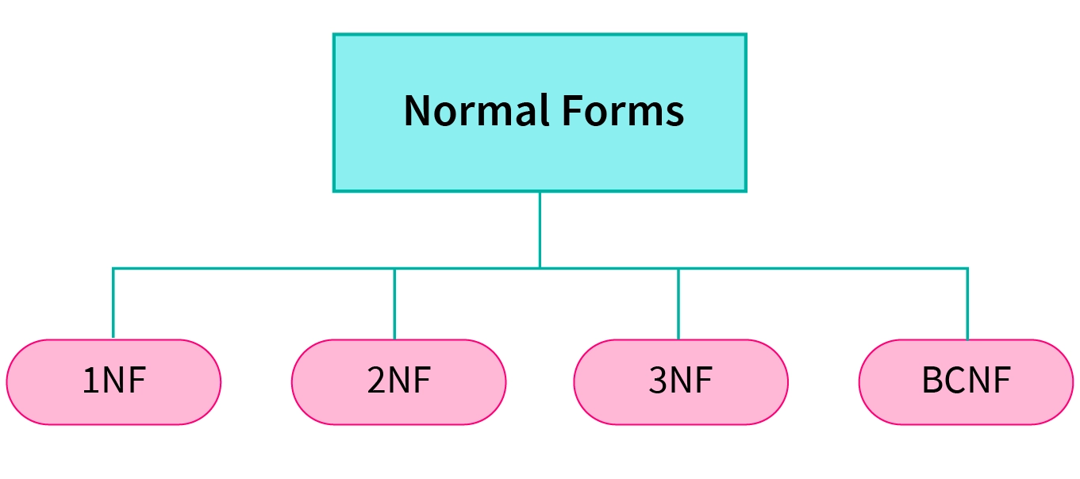
Normalization Forms

Slide 14
Advantages of Normalization
Normalization helps to minimize data redundancy.
Greater overall database organization.
Data consistency within the database.
Much more flexible database design.
Enforces the concept of relational integrity.

Slide 15
Disadvantages of Normalization
You cannot start building the database before knowing what the user needs.
The performance degrades when normalizing the relations to higher normal forms, i.e., 4NF, 5NF
It is very time-consuming and difficult to normalize relations of a higher degree.

Slide 16
1NF (Normal Form)
A relation will be 1NF if it contains an atomic value.
An attribute of a table cannot hold multiple values. It always hold only single-valued attribute.
1NF Form disallows the multi-valued attribute, composite attribute, and their combinations
Each entry in a column must contain a single value.

Slide 17
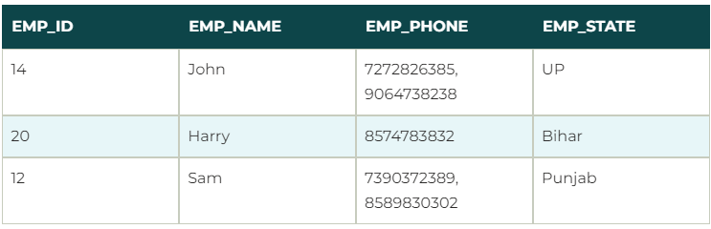
Example of 1NF
Relation EMPLOYEE is not in 1NF because of multi-valued attribute EMP_PHONE

Slide 18
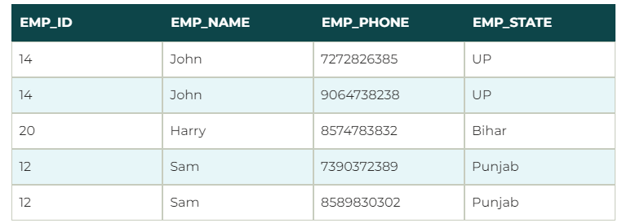
Example of 1NF
After applying 1NF Form on the EMPLOYEE relation we get following:

Slide 19
2NF (Normal Form)
In the 2NF, relational must be in 1NF
In the second normal form, all non-key attributes are fully functional dependent on the primary key
Eliminate partial dependencies (non-prime attributes must depend on the entire primary key).

Slide 20

Example of 2NF
Let's assume, a school can store the data of teachers and the subjects they teach. In a school, a teacher can teach more than one subject.

Slide 21
Example of 2NF
to convert the given table into 2NF, we decompose it into two tables:
In the given table, non-prime attribute TEACHER_AGE is dependent on TEACHER_ID which is a proper subset of a candidate key. That's why it violates the rule for 2NF

Slide 22


Example of 2NF

